Slide 1
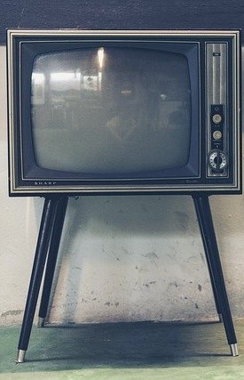
LECTURE two (A): Characteristics of light and sound
ET 8105 – Television Systems

Slide 2
INTRODUCTION
The word ‘television’ has its origin in two Greek words ‘tele’ and ‘vision’. Tele means ‘at distance’ and vision means ‘seeing’
The fundamental aim of a television system is to extend the sense of sight beyond its natural limits, along with the sound associated with the scene being televised.
Before the study of the elements of a TV transmitting and receiving system is taken up, it is necessary to study the characteristics of light and sound which have to be transmitted for receiving TV programmes at a distance.

Slide 3
Units of Light
Light is emmited from different sources with different illuminating power. E.g. Lamp, phosphor element on a fluorescent screen, candle, etc.
Candela – the unit of light based on blackbody radiation. Blackbody radiations at a definite temperature are constant in intensity and therefore can be used as an accurate standard.
The unit based on blackbody radiation is called candela (cd).
The above standard of candela is known as the primary standard. As the primary standard cannot be used readily, secondary standards have been developed

Slide 4
Units of Light
The amount of visible light which flows from a source in one second is known as luminous flux.
Unit of luminous flux is Lumen.
One lumen is the luminous flux per unit solid angle due to a point source of light of one candela power.
Lumen is also defined as the flow of light energy per second through one square meter of a surface of 1 metre radius when a source of 1 candela is placed at the centre.

Slide 5
Units of Light
Intensity of illumination is represented in units, known as lux (written as lx in short) or metre-candela.
One lux is the amount of light falling on a square metre spherical surface of radius 1 metre when a source of 1 candela is kept at the centre of curvature of the sphere.
1 lux = 1 lumen per square metre
Lux is a small unit. A bigger unit is phot which measures 1 lumen per square cm. Thus 1 phot = 10000 lux.

Slide 6
Brightness vs Intensity of Illumination
Brightness of a surface depends on the reflecting power of the surface.
If two objects are illuminated with equal intensity, their brightness may be different.
For example, if two opposite walls of a room are painted differently, one is painted white and the other red, the intensity of light falling on the two walls is the same, but the white wall will appear brighter than the red wall.

Slide 7
Units of Sound
Sound consists of pressure waves and hence its intensity is represented in units of pressure, that is, newton per metre square (N/m²), or pascal (Pa).
It is also represented in watt per metre square (W/m²).
Generally, it is indicated in decibels (dBs) over threshold of hearing, which is equal to 10^{–12} W/m² or 1 pW/m².

Slide 8
Intensity of Light in a Picture
The intensity of illumination can vary from darkness (light of faint stars in the universe, which is taken as reference = 0 dB) to light of bright sun on snow (110 dB)
A scene consists of variations of intensity of light and colour in space in three dimensions and its image in two dimensions.
The variations may be sharp (abrupt) or may show slow gradation of shade from white (brightest light) to black (zero light).
The rate of variation of the intensity represents frequency of variation. In TV it may vary from 0 to about 5 MHz.

Slide 9
Image
An eye senses the variations of light occurring in its field of view and forms an image of the scene on the retina.
A camera similarly picks up a portion of the scene falling in its field of view and forms its image on a photographic film (as in cinema) or on a semiconductor plate (as in TV camera tube).
The image is thus a two-dimensional picture on a plane surface.
The effect of the third dimension (depth) in the image is produced by the fact that light from the distant objects is of reduced intensity, the reduction being proportional to the distance.

Slide 10
Picture Frame
When a scene is filmed, the field of view of the lens being limited, the camera catches a small portion of the scene when its shutter is opened.
The image recorded on the film in an exposure is called picture frame.
Each exposure gives a still picture.
If a scene does not change (e.g. a hill or a building), all exposures will give the same image.
However, when an event is filmed, the scene changes from instant to instant.

Slide 11
Picture Frame
Recording of a changing scene requires several exposures in quick succession.
In cinema, there are 24 exposures (photographs) per second recorded on 24 films, moving and coming in the focus of the camera lens one after the other.
In television. The TV camera lens continuously focuses the scene on a target plate. There are no shutters opening or closing.
The image is converted into an electrical charge-image, and electrical signal is extracted from each point of the charge image in quick succession by a continuous extraction process with interruption (akin to closing the shutter) every 40 millisecond.

Slide 12
Picture Frame
In TV, the process of extraction of signal from point to point is called scanning and interruption is called blanking.
25 frames are scanned in one second in European system (adopted by India) and 30 in American system.
This difference in the two systems is due to electric mains frequency being 50 in Europe and 60 in America)
Each sequence of scanning in TV (like each exposure in cinema) is called a frame.

Slide 13
Aspect Ratio
Width to height ratio of a picture frame is called aspect ratio.
Width is kept longer than height because of the following facts:
Horizontal dimension of a scene is generally more than its vertical dimension.
Eyes can move with more ease and comfort in the horizontal plane than in the vertical.
The fovea, the surface of maximum sensitivity and resolution at the centre of the retina in the eye has greater width than height. Thus, the longer width of the image ensures more efficient use of the fovea.
As a result of intensive subjective tests by cinema professionals, aspect ratio of 4:3 was found to be most pleasing aesthetically, and less fatiguing to the eyes.

Slide 14
Aspect Ratio
Thus for conventional TV screens, the aspect ratio is 4:3 in all TV systems.
Proportional size of the objects will not change with change in size of the screen so long as the aspect ratio remains the same.
For wider screens of high definition TV, aspect ratio of 16:9 has been standardized.
Recording at 16:9 aspect ratio can be shown on 4:3 ratio screen by using full width and smaller height.
Dimensions of a TV receiver are specified by the diagonal length of the screen
By Pythagoras theorem, when width is 4x and height 3x, diagonal would be 5x

Slide 15

Example 01

Slide 16
Picture Elements
For analysis and processing, an image can be considered to be consisting of tiny areas (dots), called picture elements (PELS) or more popularly, pixels.
A photograph comprises fine grains of silver which show varying shades of light.
A printed picture (as in a newspaper) is composed of very small black and white dots.
Similarly a TV picture as seen on the screen of a picture tube in a TV receiver consists of hundreds of thousands of pixels.
These pixels are too small to be seen ordinarily.

Slide 17
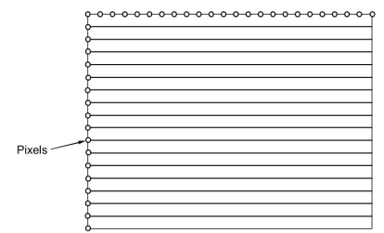
Picture Elements
The pixels, although randomly distributed, can be supposed to lie on closely spaced horizontal lines on a picture frame to simplify for understanding.
In the picture shown, there are 18 horizontal lines, and therefore there are 18 pixels on a vertical line.
As the aspect ratio is 4:3, there would be 18 x 4/3 = 24 pixels on a horizontal line.
The total number of pixels on the screen will be 18 x 24 = 432.

Slide 18
Picture Elements
In practice, there are 625 scanning lines in European system of television and 525 lines in American system.
Hence maximum number of pixels in European system would be 625 × 625 × 4/3 = 520,833, and in American System, 525 x 525 x 4/3 = 367,500.
In actual practice, pixels that contribute to the reproduction of a picture are much less than the above values (about 223,000 in European system and about 152,000 in American System) due to loss of some lines in blanking.
The concept of blanking will be explained in later lectures.

Slide 19
Details and Resolution
Closely spaced small objects or small distinct features in a picture form details.
Smaller the objects or features visible distinctly, higher is the resolution of the details or finer are the details being seen.
The ability to see the fine details in a picture is called resolution.
A pixel in a picture represents a very small area (almost point size) which possesses the characteristic brightness and colour at that point.
High resolution or high frequency of variation produces pictures of sharp outlines.
When the edges of a reproduced picture are defined sharply, the picture is said to be well defined or sharp.

Slide 20
Visual Acuteness and Viewing Distance
Human eye has resolution of 1 minute (or 1/60 degree).
This means that, if two closely spaced objects form a minimum angle of 1 minute at the eye, they would be distinctly visible.
For smaller angles, the two objects would appear as merged with each other.
The angle subtended at the eye will depend on two factors.
The space, S, between the objects.
The distance, D, from which the objects are being seen.

Slide 21
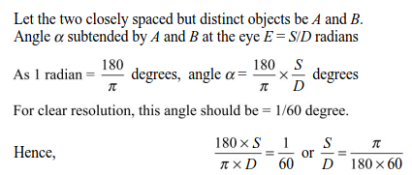
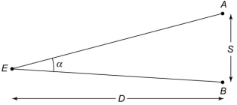
Visual Acuteness and Viewing Distance
For clear resolution, S/D is given by the equation derived as follows.
This equation will give the minimum resolvable gap S between objects and hence will give the required number of pixels

Slide 22

Example 02

Slide 23
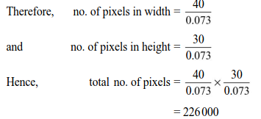
Example 03
Calculate the number of pixels in 50 cm size TV screen for Example 02.

Slide 24
Visual Acuteness and Viewing Distance
Although l’ angle criteria gives maximum resolution, it is not necessary to see a picture with maximum resolution.
Viewing distance should be such that the diagonal of the screen should subtend an angle of 10 - 15˚ at the eyes for comfortable viewing.
This gives the viewing range of 2 – 3 m for a 50 cm size TV receiver.
As the number of pixels are the same in TV receivers of different sizes, the space S between adjacent pixels will be less in smaller size screens and hence the viewing distance will be smaller.
With the aspect ratio of 4:3, the viewing distance of 6 to 8 times the height of the screen is considered satisfactory

Slide 25
Visual Acuteness and Viewing Distance
Viewing distance will also depend upon the brightness of a picture.
In American TVs, pictures are brighter than Indian TVs.
Hence viewing distance for the American TVs can be more and therefore spaces between pixels can be greater.
This, in turn, means that the number of pixels is smaller and hence the number of scanning lines per frame is also smaller.
This is the reason why the American TV system has 525 lines per frame while the Indian system has 625 lines per frame.

Slide 26
Persistence of Vision
When the eye sees light, it continues to see it for about 60 ms after the light source is removed.
This property of the eye is called persistence of vision.
It has been possible to see movie pictures because of this property of the eyes.
Due to persistence of vision, we see the continuous motion in movie pictures, and similarly in television.
The picture frames displayed on a TV screen change one after the other faster than persistence of vision.
Display of each complete frame takes only 40 ms in Indian system of 25 frames per second and about 33 ms in American system of 30 frames per second, while persistence of vision is 60 ms.

Slide 27
Flicker
Time of persistence of vision is more for darkness than for bright light.
This results in a phenomenon called flicker.
It means that, dark intervals between bright pictures become visible for a very short time and appear as flicker.
In Television, the problem of flicker is eliminated by a technique called interlaced scanning, the concept that will be explained in later lectures.

Slide 28
Brightness
Brightness in TV pictures is the average intensity of light.
It determines the background level of illumination in the reproduced picture.
The eye adapts itself to the average prevailing brightness and sees all variations with respect to this adapted value.
In TV receivers, brightness (average illumination on the screen) can be increased or decreased by changing the dc bias between the control grid and cathode of the picture tube.

Slide 29
Tonal Gradation
While a TV picture may have an overall average level of brightness, the illumination of any individual pixels on the screen may vary from one pixel to the other.
Variation from pixel to pixel is called tonal gradation.
If the whole picture is of one intensity (say white screen), there is no variation and hence rate of variation is zero.
If the intensity changes from one pixel to the next (adjacent) pixel, the rate of variation of intensity is maximum.
This maximum rate of change of variation is the bandwidth of variation of light, and is about 5 MHz.

Slide 30
Contrast
A TV picture has an overall average level of brightness.
Illumination value of an individual pixel on the screen will vary above and below this average value.
Thus illumination of a pixel will appear differently with different brightness of the background.
For example, a white pixel will appear very white in contrast with black background (or low brightness), but will appear dull white in white background.
The illumination value of a pixel vis-a-vis background illumination is called contrast.

Slide 31
Contrast
Contrast is therefore defined as the luminance values between white and black.
This difference will depend on the strength of the video signal responsible for glowing an individual pixel.
The contrast control is located in the video signal amplifier.
As contrast is the variation in brightness of individual pixels over the general average brightness of the whole screen, the two phenomena (contrast and brightness) are inter-related.

Slide 32
Brightness vs Contrast
When general brightness level is increased, grey will appear black and so general contrast level will also increase.
To get the most soothing effect, brightness level is kept low, and then the contrast is adjusted to a pleasing value.
After adjusting the contrast, the brightness level may again be adjusted so that overall brightness and contrast give the best soothing effect to the viewer.

Slide 33
Characteristics of Colour
Light is a visible form of electromagnetic energy.
It has two visible characteristics: intensity and colour
Intensity as seen by the eye is represented by luminance and colour by the wavelength.
Light of a specific wavelength shows specific colour.
Range in wavelength of the visible colour varies from about 400 nm (violet) to about 700 nm (red)
There can be unlimited wavelengths and hence unlimited colours within this range, but the eye cannot distinguish them so closely.
In practice, the eye is able to see colours in broad bands of wavelengths.

Slide 34
Resolution and Bandwidth of Colours
Eyes cannot see colours of very small objects.
Such objects are seen by the eye as colourless or black and white.
Relatively bigger objects show the colour.
Hence resolution and bandwidth of colour are much lower than for the monochrome light.
While bandwidth of monochrome light is about 5 MHz, the bandwidth of colour is less than 1.5 MHz
This property of the eye is used in interleaving of colour signals in between the monochrome brightness signals.

Slide 35
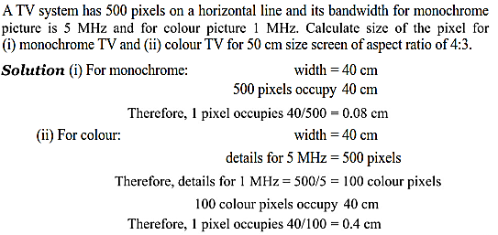
Example 04
Notes:
The above example shows that a monochrome pixel would be resolved if its width is 0.08 cm, while a colour pixel can be resolved only if its width is 5 times bigger.

Slide 36
Colour Temperature
A tungsten filament when heated emits light whose colour depends on the temperature of the filament.
At lower temperatures, the light is red and as the temperature increases, other wavelengths are produced and finally it emits nearly white light.
This shows that there is a relationship between colour and temperature.
Colour temperature is the term used to indicate the colour which will be radiated by the black body heated to a specified temperature.

Slide 37
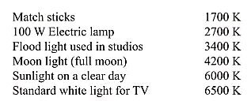
Colour Temperature
The term ‘colour temperature’ is used to denote the colour of the source of light in the sense that the source emits the colour which would be radiated by the black body radiator at that temperature.
Typical colours emitted by different types of sources are represented by colour temperatures as follows:

Slide 38
Primary Colours
There are three primary colours: red, green and blue.
They are called primary because all other colours can be obtained by mixing these three colours in appropriate proportions.
An eye also perceives the colours by such a mixing process.
There are groups, each of three cones, behind the retina of the eye. One cone of each group responds to red light, the other one to green and the third one to blue.
The brain integrates these responses by additive mixing and perceives the resultant colour which was incident on the eye.
Also there are rods attached to the retina, which respond to the brightness present in the incident light.
Thus the brain interprets colour and its brightness

Slide 39
Complementary Colours
When any two primary colours of equal intensity are mixed, the resultant colour is called complementary colour.
They are also known as secondary colours.
There are three complementary colours: yellow, cyan and magenta.
These are obtained as follows:
Red + Green = Yellow
Green + Blue = Cyan
Blue + Red = Magenta
They are known as complementary colours because when combined with the remaining primary colours, they give white.
Yellow is complementary to blue because yellow plus blue will give white. Cyan is complementary to red, and magenta to green.

Slide 40
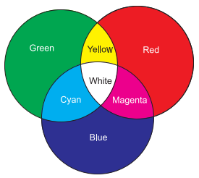
Additive Mixing of Colours
When light of different colours from independent sources reaches the eye, there is additive mixing of the colours, resulting in a different colour.
Secondary colours result when two primary colours of equal magnitude are additively mixed.
Colours emitted by the glowing phosphor elements of the picture tube of a TV receiver give the additive colour.

Slide 41
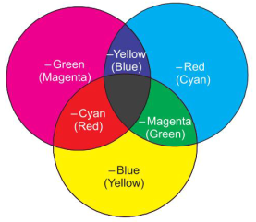
Subtractive Mixing of Colours
Subtractive mixing pertains to the subtraction of the colour by an object from the incident light.
The net colour received after subtraction will be the colour of the object.
When white light is incident on a blue object, it will absorb green and red lights, and therefore only blue light (white – green – red) will reach the eye.

Slide 42
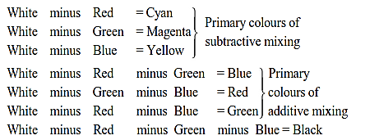
Subtractive Mixing of Colours
Secondary colours of additive mixing are called primary colours of subtractive mixing. Result of subtractive mixing is shown below:

Slide 43
Additive vs Subtractive Mixing
There is a clear distinction between additive mixing and subtractive mixing.
The former pertains to the light emitted by the sources, the glowing objects, while the latter pertains to the absorption of light by the objects.
The eye adds the colours that reach it.
Thus at the eye, it is always additive mixing, whether the colours reach the eye direct from the active sources, or they reach by reflection of the light not absorbed by the passive objects.

Slide 44
Additive vs Subtractive Mixing
Image of the objects in a scene formed on the plate of a camera tube consists of colours reflected by the objects after absorbing (or subtracting) some colours.
Hence it is a result of subtractive mixing.
The picture formed on the screen of a picture tube is due to the glow of phosphor elements and hence the resultant colour is a phenomenon of additive mixing.

Slide 45
Hue, Saturation and Luminance
Coloured light has three components: hue, saturation and luminance.
Hue - It represents wavelength of the light reaching the eye.
As the eye cannot distinguish between the closely spaced wavelengths, hue is the dominant spectral colour of the received light.
It is also termed as tint
Hue is independent of brightness.
When we say that rose is red, it may be very bright or may be quite dull in brightness, but its hue will remain red only.

Slide 46
Hue, Saturation and Luminance
Saturation - It represents how much white is present in a colour.
White light dilutes a colour.
Absence of white in a colour makes it fully saturated or vivid colour.
If a colour is not fully saturated, it means white (or the three primary colours in equal proportions) is present to some extent in the colour.
For example if light consisting of 1 lumen of blue, 0.1 lumen of red and 0.1 lumen of green reaches the eye, then the eye will see it as 0.9 lumen of blue and 0.1 lumen of white and its saturation would be 90%
Saturation also does not depend on brightness

Slide 47
Hue, Saturation and Luminance
Luminance - It is the measure of visual sensation of the quantity or brightness of light emitted from a pixel.
It is different from the average brightness which determines the background level of illumination.
Thus while brightness takes into account the illumination of the surroundings, luminance is not concerned with the surroundings.
It is concerned with the pixel from which light is being emitted.
The output of a monochrome TV camera is proportional to the luminance for each pixel.

Slide 48
Grassman’s Law
The eye is not equally sensitive to all colours.
Its sensitivity if 59% for green, 30% for red and 11% for blue.
Hence the output of the colour camera is to be reduced by the above factors to get the luminance (represented by Y).
The luminance is given by Grassman’s law which is stated as follows:
When a colour is produced by adding three primary colours, its luminance is the sum of the luminances of individual primary colours

Slide 49
Grassman’s Law
The Grassman’s law is represented by the following equation:
Y = 0.59(G) + 0.30 (R) + 0.11(B)
where G, R and B are the intensities of green, red and blue lights.
Here Y does not mean yellow, but it only represents Y-coordinate of an equation and gives luminance value of a pixel.
According to the above equation, if G, R and B are 1 lumen each for the colour camera, then the resultant white (luminance signal) will be 1 lumen, consisting of 0.59 lumen of green, 0.3 lumen of red and 0.11 lumen of blue (0.59 + 0.30 + 0.11 = 1)

Slide 50
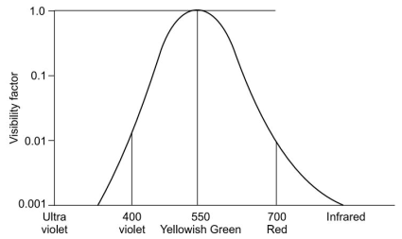
Visibility Curve for the Eye
Visibility function or photopic response of the eye refers to the non-uniform response of the eye to lights of different wavelengths.
Example
Infrared, ultraviolet light, X-rays and other higher frequency radiations are not visible to the eye.
Yellowish-green colour is most visible

Slide 51

Tristimulus Values
The three primary colours can produce any other colour by mixing in appropriate proportions.
As a result of subjective experiments, the component values of the three colours have been standardised for television.
These component values are called tristimulus values.
The neutral white which is used as reference white for TV is a mixture of:

Slide 52
Tristimulus Values
If brightness of each colour is reduced by a common factor, the resultant will represent shades of white, e.g. light grey, grey and dark grey.
When brightness of all the primary colours is zero, the resultant is black.
If 1 lumen of each primary colour gives white, then 0.8 lumen of each may give light grey, 0.5 lumen of each, grey and 0.3 lumen of each, dark grey.
If the magnitudes of the primary colours are not equal, some colour (other than shades of grey) will be produced by additive mixing and its saturation will depend upon the quantity of white present in the colour.

Slide 53
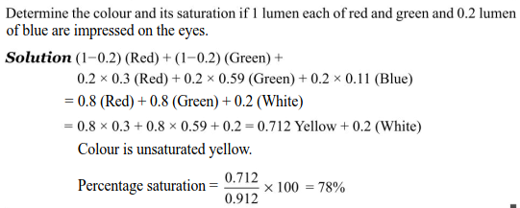
Example 05

Slide 54
Reading Assignment
Spare sometime and read about
Colour Triangle
Chromaticity Diagram
Spectral and Non-spectral Colours and
Colour Circle

Slide 55
Characteristics of Sound
Sound is invariably associated with television programmes.
Hence quality of sound is as important as quality of picture for enjoying a TV programme.
Good sound should be free of noise and distortion and should have comfortable volume.
Characteristics of sound depend on the source producing sound waves and on the ear responding to these waves.
The main characteristics are Intensity and Frequency.

Slide 56
Intensity of Sound
Sound waves vary in intensity, changing from the just audible sound, lower than even the rustle of leaves to very loud sound as heard in thunder or loud Rock ‘n’ Roll bands.
Just audible sound has the intensity of one picowatt per sq. metre (10⁻¹² W/m²) and is taken as reference 0 dB.
It is called threshold of hearing
With this reference, sound of rustle of leaves is 10 dB, whisper 20 dB, conversation 50 dB, normal speech 74 dB, thunder 100 dB and a loud Rock ‘n’ Roll band in a small hall 120 dB. Intensity of 130 dB causes pain.
These intensities are for the ear

Slide 57
Frequency Range of Sound
Another important characteristic of sound is its frequency.
It varies from the lowest frequency of 16 Hz to the highest frequency of 20,000 Hz.
It can take any value within this range.
Outside this range our ears will not hear the sound.
It is ultrasonic beyond 20,000 Hz and infrasonic below 16 Hz.
Sound emanating from person(s) or musical instruments consists of a fundamental frequency range and its harmonics which give characteristic recognisable sound for individuals

Slide 58

Frequency Range of Sound
Fundamental frequency range of a man’s voice may be 110 – 2000 Hz, but it extends to 8000 Hz due to harmonics.
For good quality sound, fundamental frequencies as well as harmonics of the original sound must be reproduced faithfully.
Complete range of voice frequencies (16 Hz – 20 kHz) is called baseband of sound.
Different portions of this baseband are used for different purposes as mentioned below:

Slide 59
Bass and Treble
Bass pertains to low frequency notes and treble to high frequency notes.
Generally the receiver is designed to amplify all the frequencies equally well (from 16 Hz- 20000 Hz).
However, some people like depth in sound which is given by boosting the low frequencies (bass boost); some people like sharp sound and want treble more than bas (treble boost).
Sound systems use RC filter circuits to incorporate bass and treble controls, so that sound to individual’s taste may be produced.

Slide 60
Transducer for Light and Sound
Transducer is a device which converts physical phenomenon into electrical signals and vice versa.
Transducer for light is a camera tube, using a semiconductor target, which has photosensitive property.
When light falls on the semiconductor target, electrons are generated in the target.
The number of electrons produced is proportional to the intensity of light.
These electrons are used to develop voltage (called video signal) across a load resistor.

Slide 61
Transducer for Light and Sound
Transducer for sound is a microphone.
When sound strikes a diaphragm, it moves to and fro in a magnetic field.
A coil is attached to the diaphragm and the emf is induced in the coil as per rules of electromagnetic induction.
This voltage is called audio signal.
Video signal is converted back to light by a cathode ray tube, called picture tube.
Audio signal is converted back to sound by a loudspeaker.

Slide 62
End of Lecture 2A

